Slide 1

Fort Ord Reuse Authority (FORA)
Environmental Services Cooperative Agreement (ESCA)
Remediation Program (RP)
ESCA Remediation Program Update
Presentation by:
Stan Cook, Program Manager
April 12, 2013 Board of Directors Meeting
1

Slide 2
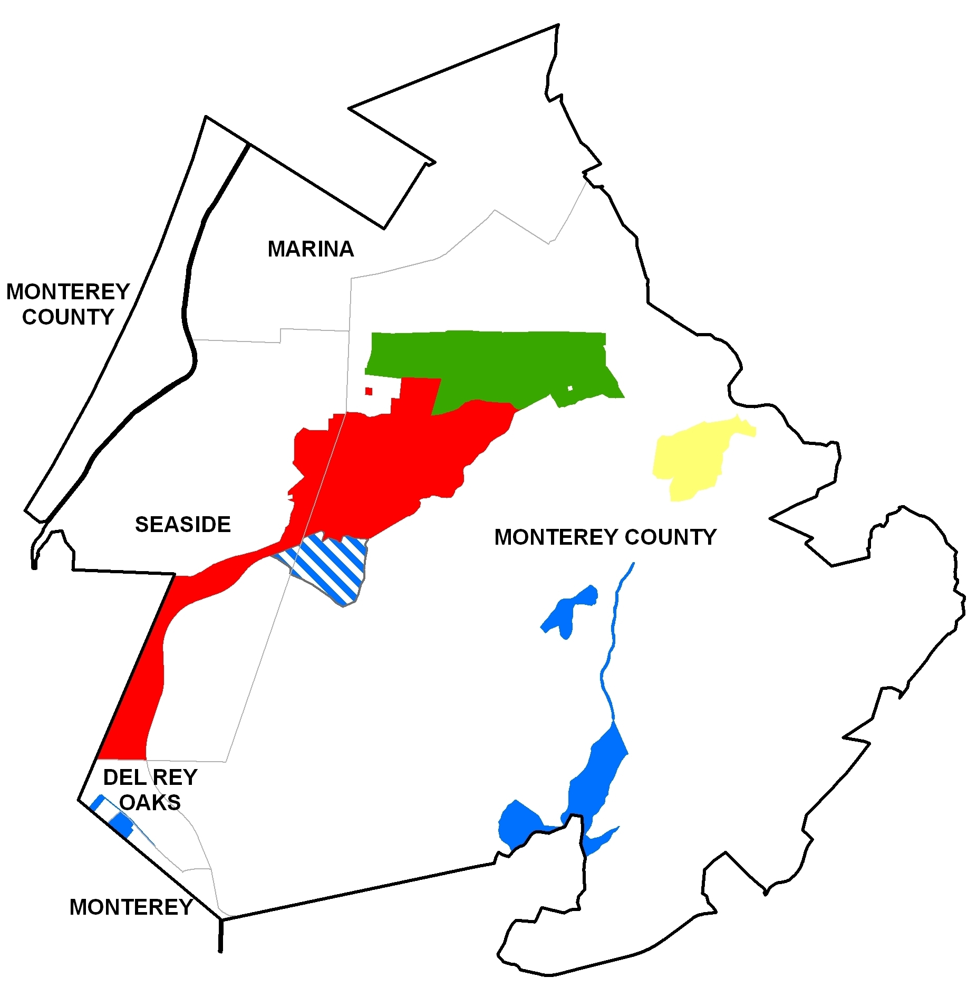
Presentation Overview
ESCA Background
Project Status
  Finances
  Work Completed
Fieldwork Update
  Parker Flats RQA
  Future East Garrison
  Interim Action Ranges
2013 Document Schedule
2013 Community Involvement
2

Slide 3
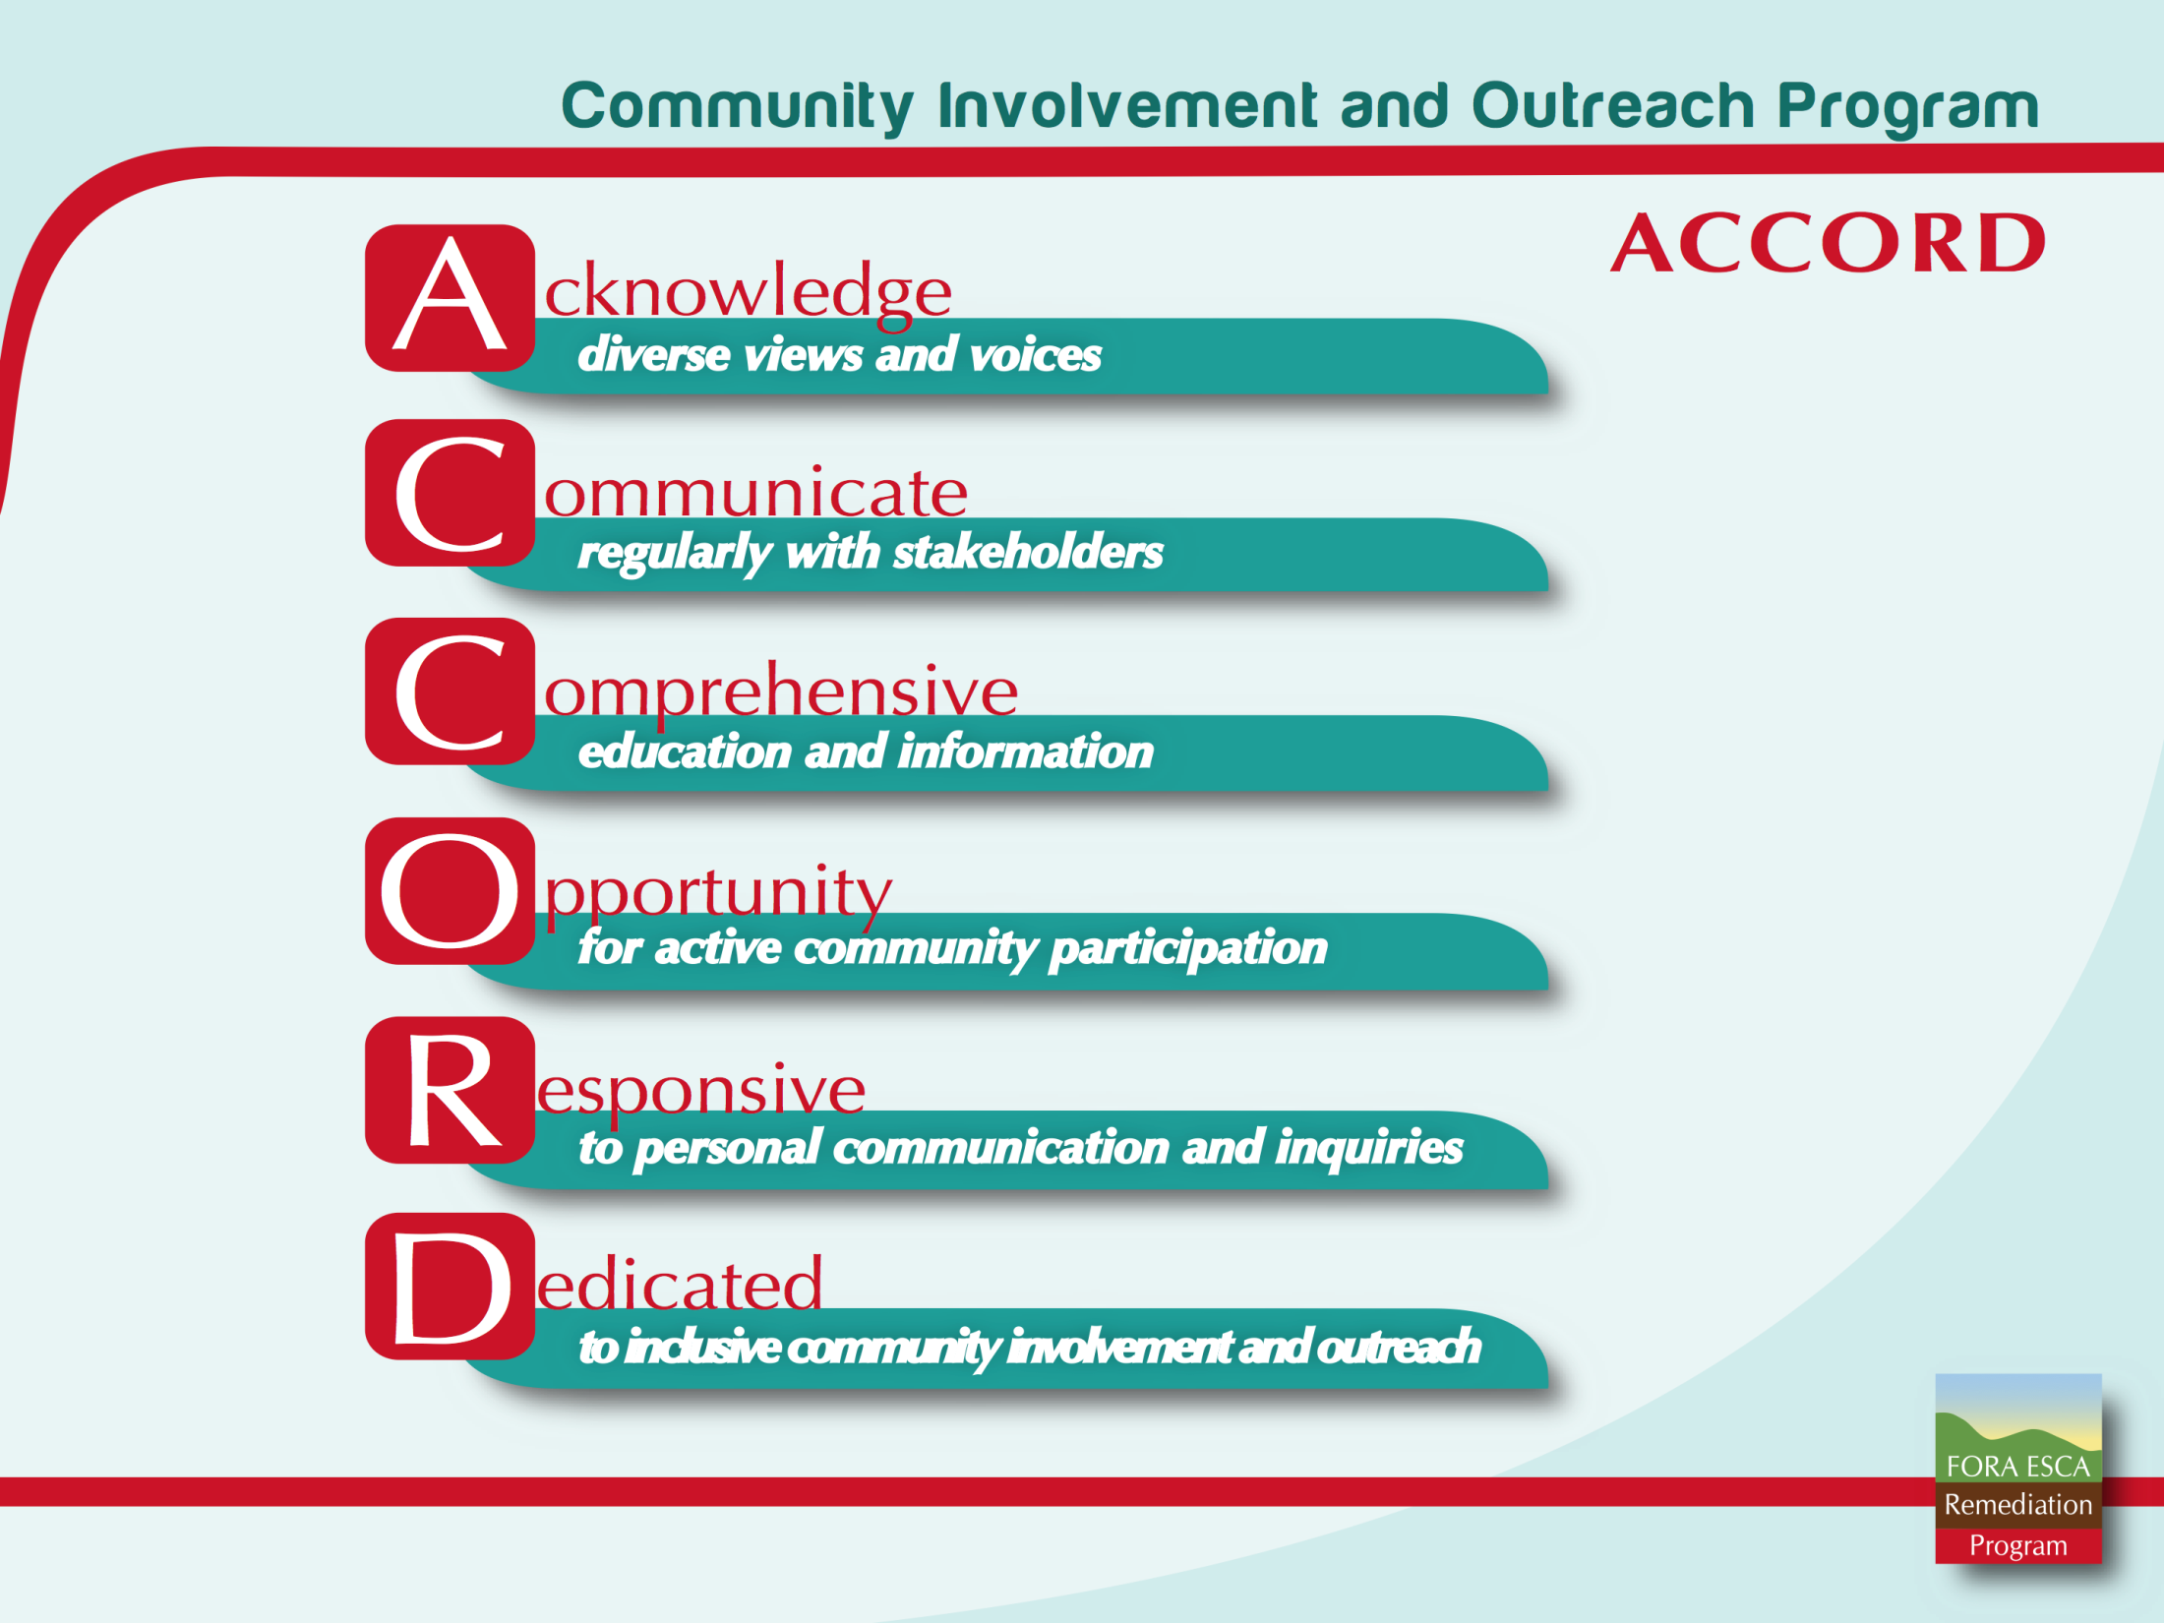
3

Slide 4
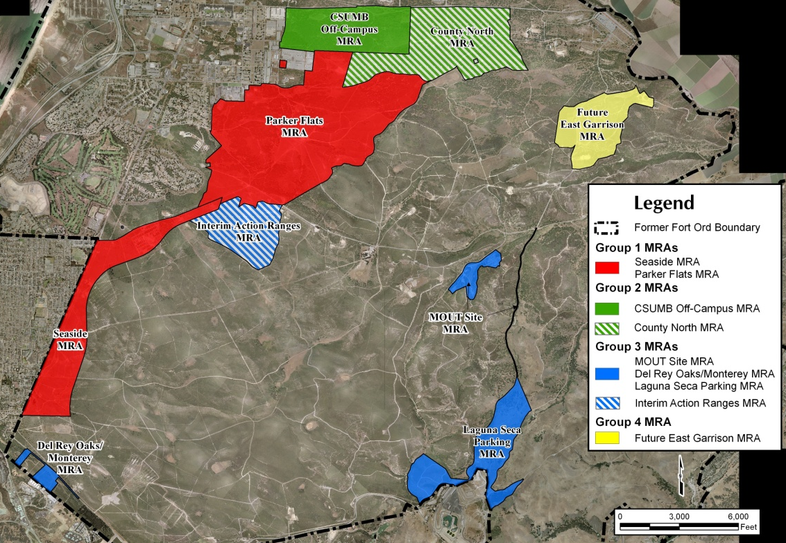
ESCA Munitions Response Areas by Group
4

Slide 5

ESCA Finances
Item | Originally Allocated | Accrued as of Jan 1, 2013
FORA Self-Insurance or Policy | $ 916,056 | $ 916,056
Reimburse Regulators & Quality Assurance | $ 4,725,000 | $ 1,797,300
State of California Surplus Lines Tax, Risk Transfer, Mobilization | $ 6,100,000 | $ 6,100,000
Contractor's Pollution Liability Insurance | $ 477,344 | $ 477,344
Work Performed ARCADIS/AIG Commutation Account | $ 82,117,553 | $ 58,496,937
FORA Administrative Fees | $ 3,392,656 | $ 2,249,691
Total | $ 97,728,609 | $ 70,037,329
 | ESCA Remainder | $ 27,691,280
Based on Army and EPA requirements in the ESCA Grant and the AOC FORA does not control the ARCADIS/AIG $82.1M Commutation Account. The full amount was provided to AIG in 2008 to as payment for a cost-cap insurance policy where AIG reviews ARCADIS’ work performed and makes payments directly to ARCADIS.
5

Slide 6
ESCA Work Completed
Planned Remedial Investigation fieldwork completed: 98% *
Planned habitat restoration and monitoring completed: 70%
Total munitions items removed: over 4,950
Total munitions debris removed: over 56,400 lbs.
Total trash (other debris): over 118,000 lbs.
  * Remedial investigation data will be reviewed with the regulatory agencies to evaluate residual risk. Additional remedial investigation fieldwork and/or remedial action fieldwork (as presented in Proposed Plans and Records of Decision) may be necessary based on the evaluation.
Note: Percentages and totals are approximate.
6

Slide 7
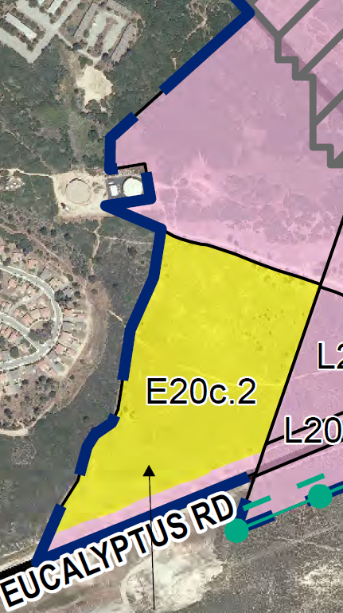
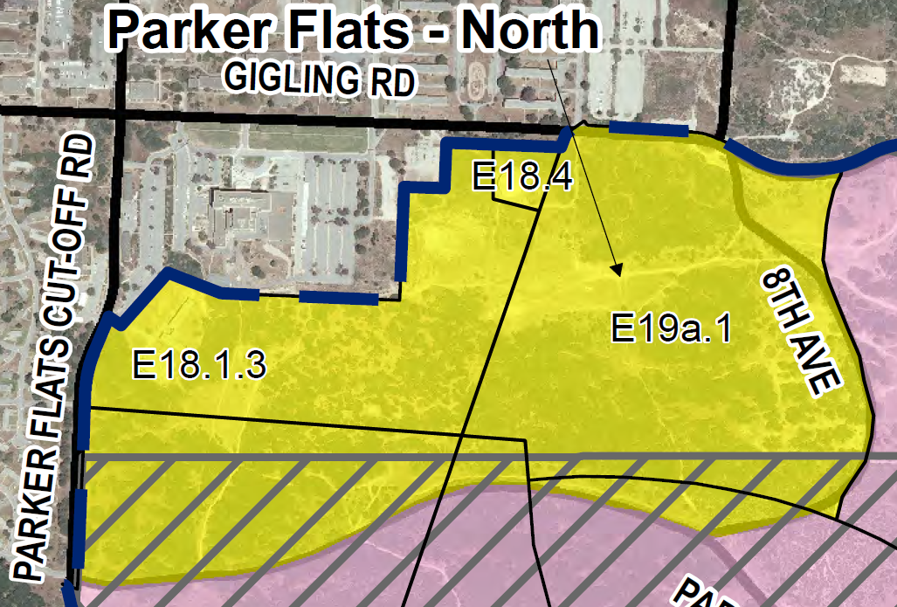
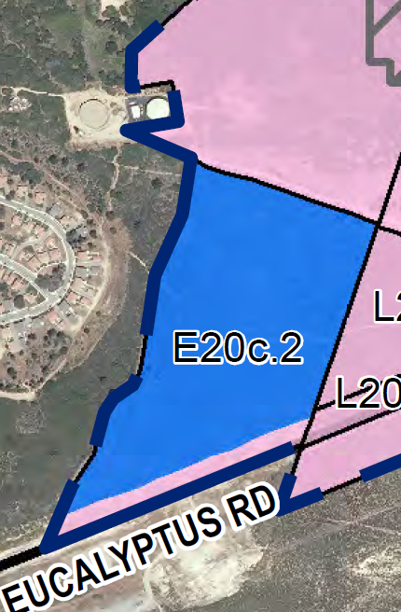
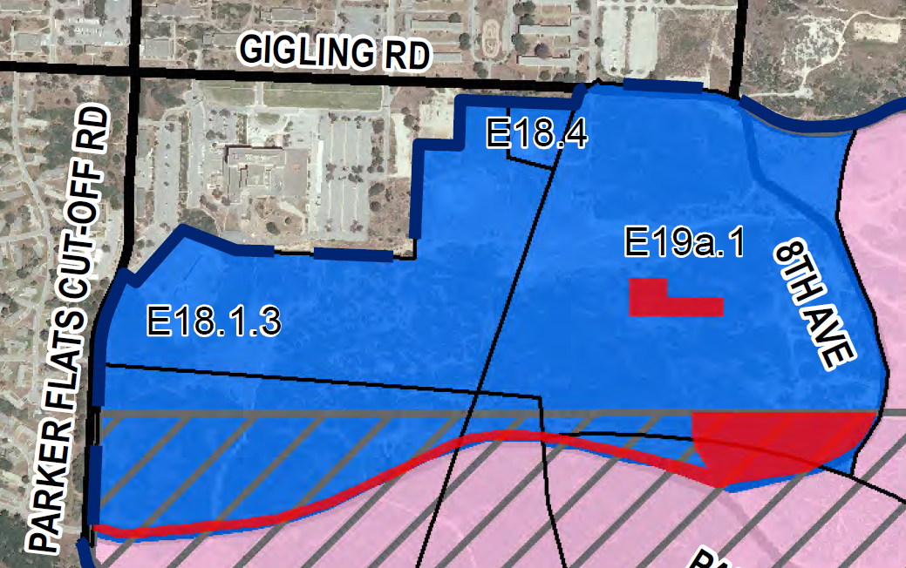
Parker Flats RQA
RQA Background
Level 1 Initial Evaluation completed on 182 acres
Level 2 Baseline DGM Survey recommended on 12 acres
September 20, 2012 -Public Meeting presented Level 2A approach
March 2013 - Level 2A fieldwork completed
Currently data being evaluated for Level 3 DGM Survey recommendation
Removed
1 MEC item
Over 20 lbs. munitions debris
Over 500 lbs. other debris
Proposed Residential Area – Northern and Southern Portions (182 acres)
Level 2A Area shown in red (12 acres)
7

Slide 8
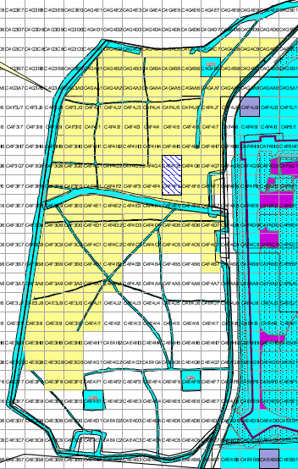
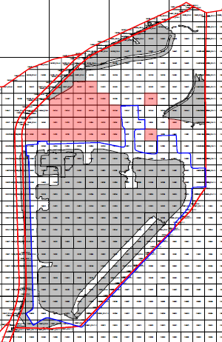
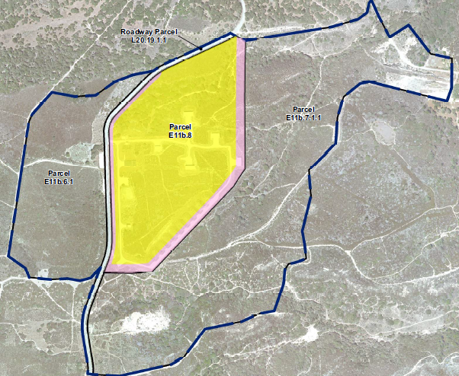
Future East Garrison
Background
East of Barloy Canyon Road - habitat reserve area - remedial investigation completed
West of Barloy Canyon Road - habitat reserve area - remedial investigation on-going (11 acres remaining)
Residential area remedial investigation - northern portion on-going (7 acres remaining)
Anticipated fieldwork completion - April 2013
Data evaluation by regulatory agencies
Removed
Over 180 MEC items
Over 7,600 lbs. munitions debris
Over 11,000 lbs. other debris
Habitat Reserve Area
West of Barloy Canyon Road
Proposed Residential Area
8

Slide 9
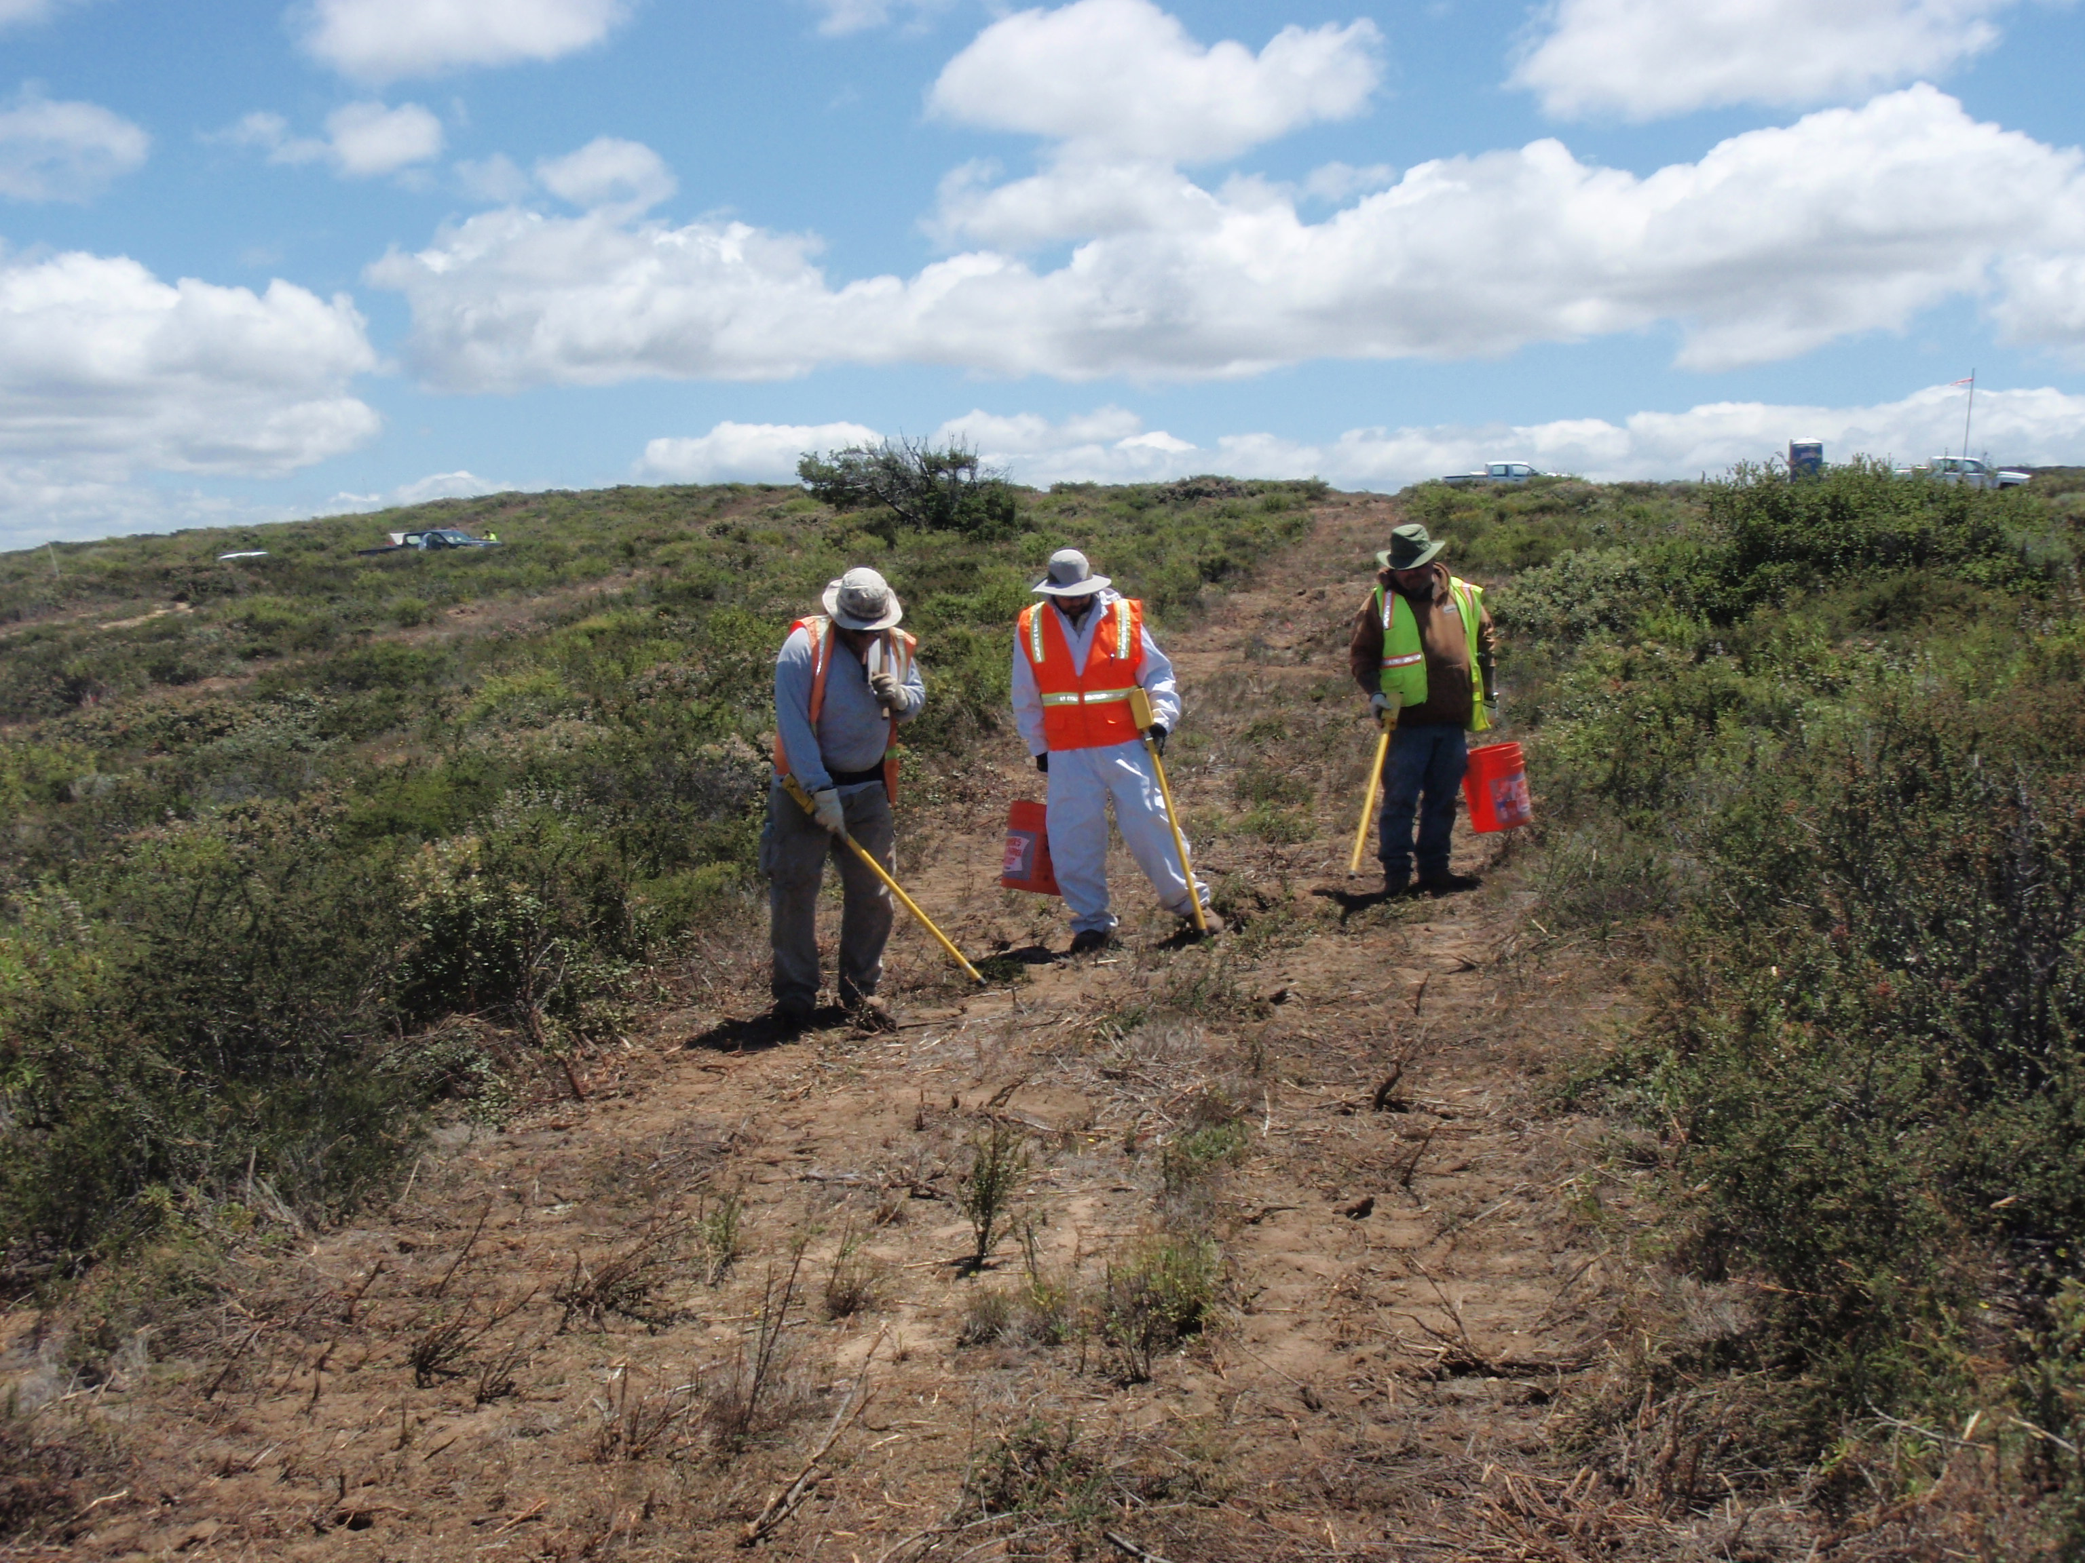
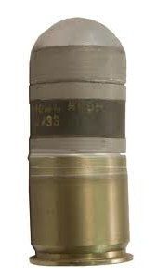
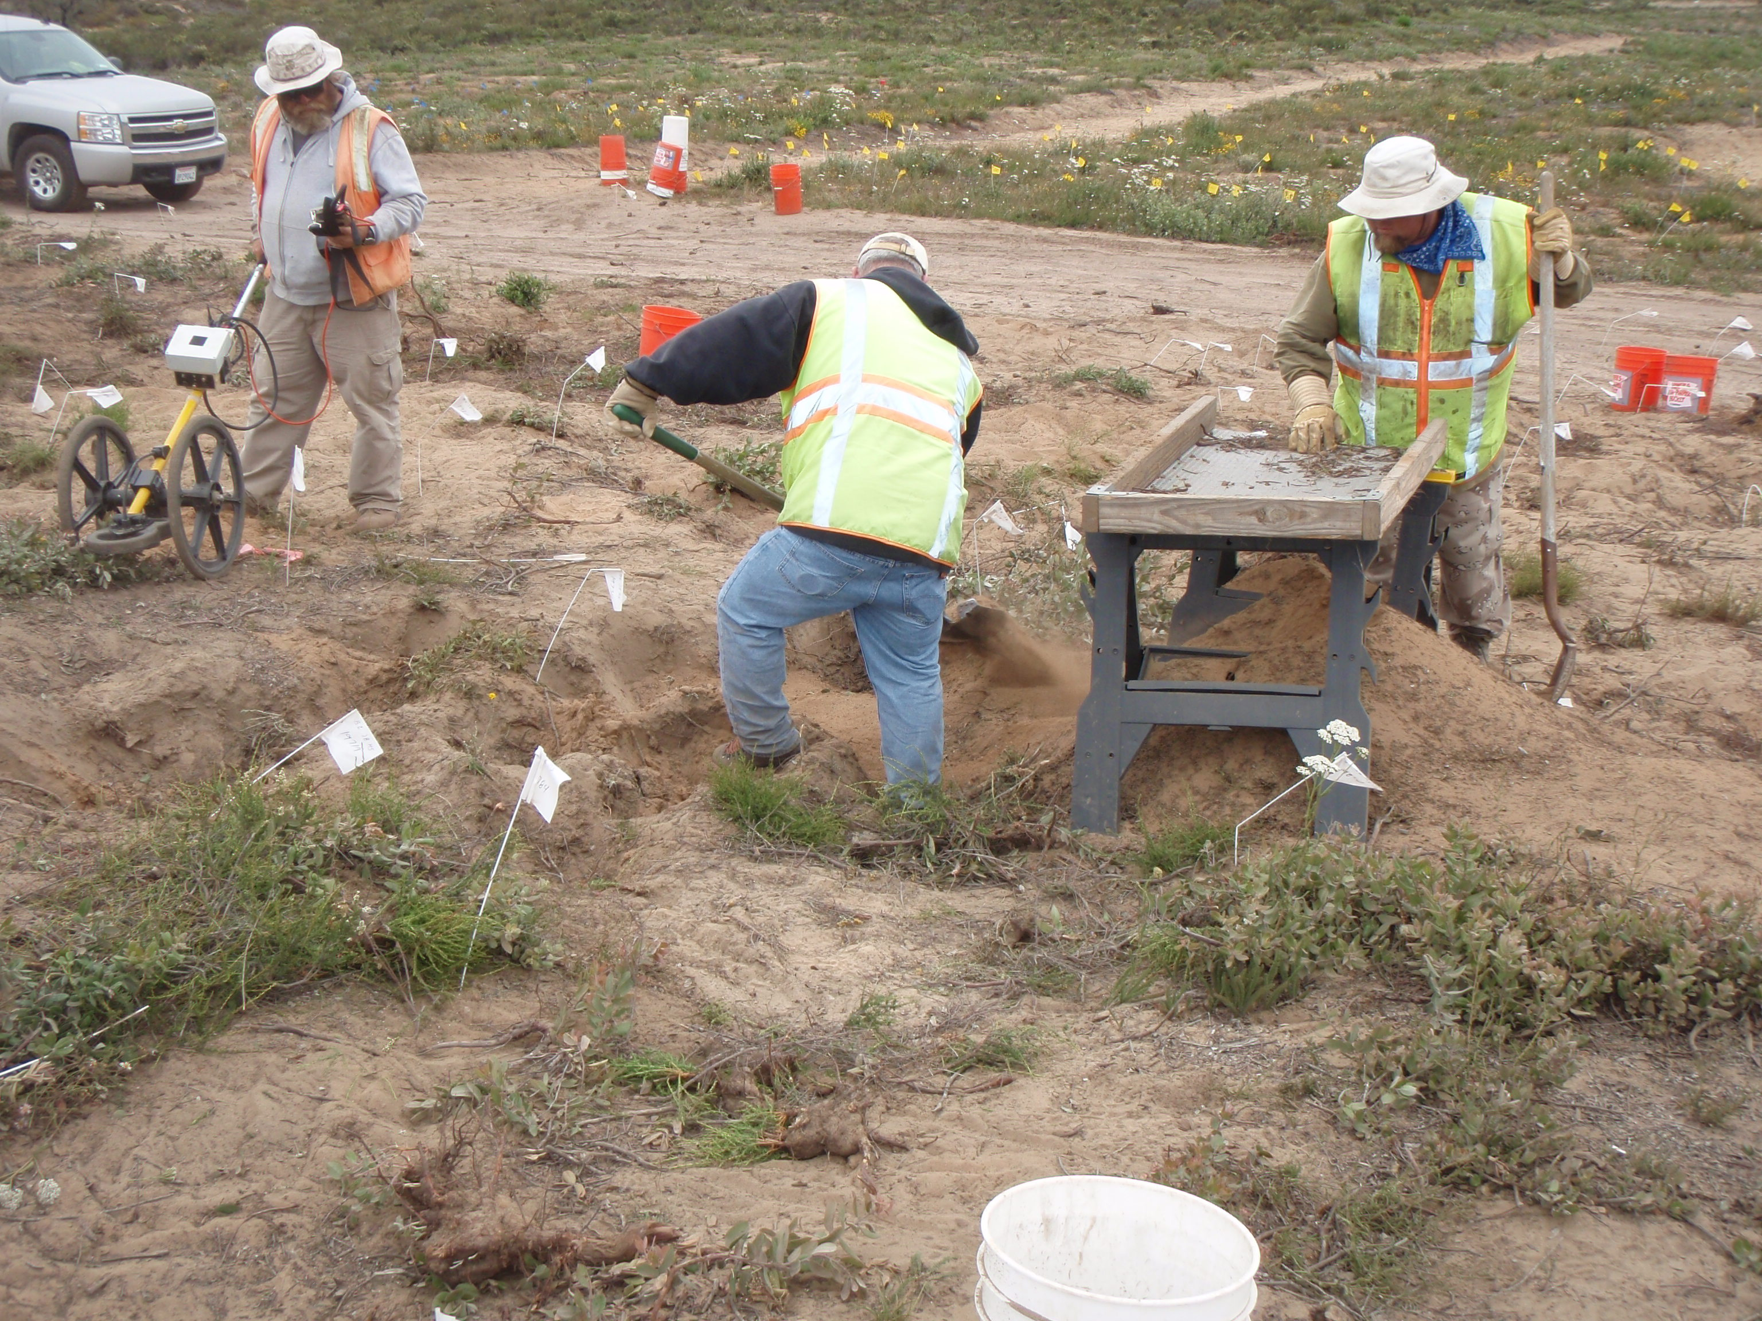
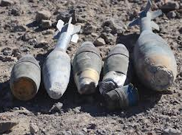
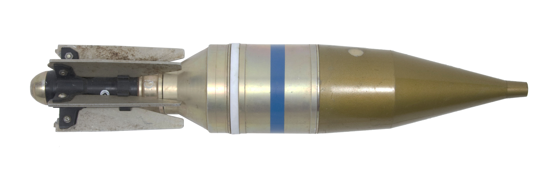
Interim Action Ranges MRA
Army Interim Remedial Action
  Completed over majority of the MRA
  ESCA Design Study and Interim Action
  Evidence of sensitively fuzed munitions
  Northern Range 44 Special Case Area Design Study Expansion
  Found 66mm rockets
  Cut vegetation, Digital Mapping
  Individual target investigation
  Range 47 SCA Interim Remedial Action
  Found 40mm grenades
  Cut vegetation, excavated and sifted soil, Digital Mapping
  Individual target investigation
  Removed
  Over 3,600 munitions items
  Over 44,000 lbs. munitions debris
  Over 11,000 lbs. other debris
9

Slide 10
2013 Document Schedule
Documents | Targeted Release
Group 1 Draft RI/FS Report, Seaside and Parker Flats MRAs | August 2013
Group 2 Final RI/FS Report, CSUMB Off-Campus MRA | February 2013
Group 2 Proposed Plan, CSUMB Off-Campus MRA | June 2013
Interim Action Ranges MRA Draft RI/FS Report | June 2013
Interim Action Ranges MRA Draft Final RI/FS Report | October 2013
Group 4 Draft RI/FS Report, Future East Garrison MRA | October 2013
10

Slide 11
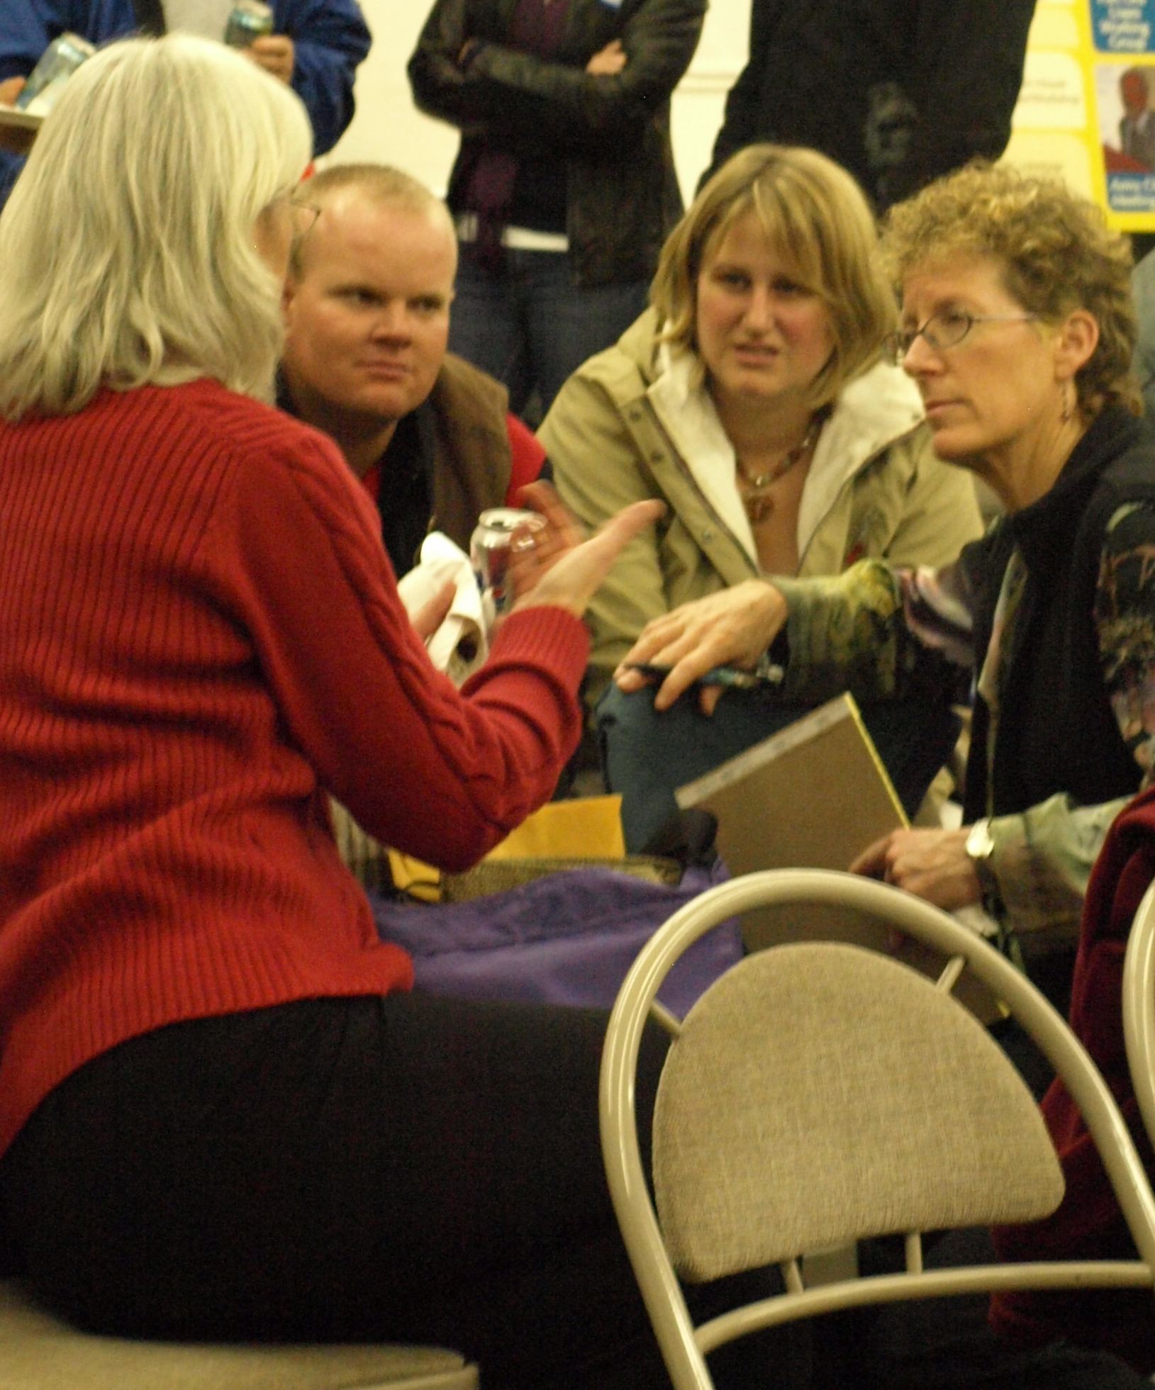
2013 Community Involvement
May: ESCA Informal Community Workshops (tentative)
June: Group 2 Proposed Plan Public Meeting (tentative)
EVENTS:
Sea Otter Classic: April 18-21
CSUMB Earth Day: April 22
Army Nature Walk: May 11
Army Community Involvement Mobile Workshop: July 13
Fort Ord Users Working Group: bi-monthly meetings
11

Slide 12
Recap
MEC remedial investigation fieldwork nears completion *
Future work – predominantly paperwork
  Dates provided
Financial update provided
How to find us?
*Remedial investigation data will be reviewed with the regulatory agencies to evaluate residual risk. Additional remedial investigation fieldwork and/or remedial action fieldwork (as presented in Proposed Plans and Records of Decision) may be necessary based on the evaluation.
12

Slide 13
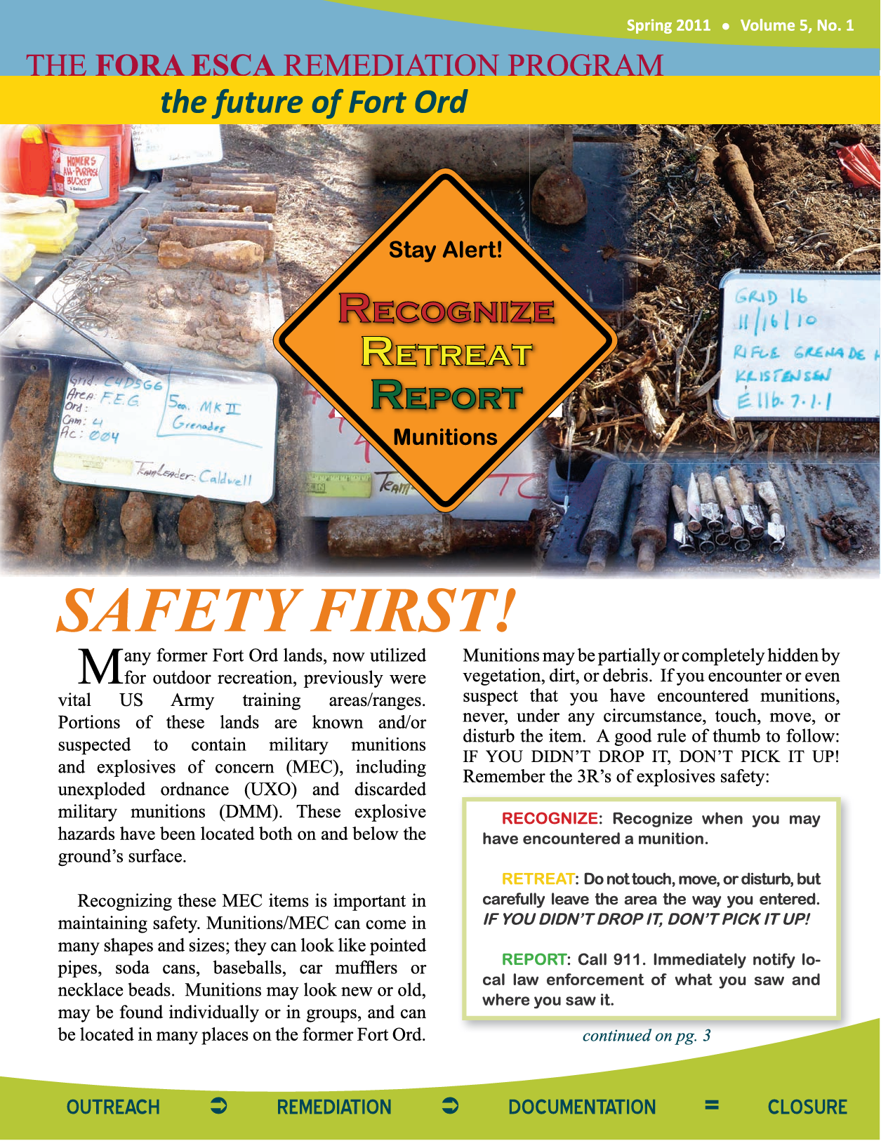
Community Resources
Website: www.fora-esca-rp.com
Newsletters & Technical Fact Sheets
Facebook and Twitter: FORA ESCA RP
Hotline Weekly Updates: (831) 883-3506
Maps showing access corridors
Kiosks at access corridor trailheads
Email: esca@fora.org
Address: 920 2nd Avenue; Suite A, Marina, CA 93933
13

